Slide 1


AI Driven Information
Retrievalfrom Image
Mentor :
Moorthy Balasubramaniam
Developed By :
Padmini Devi Singuluri
Madhu Sree Vempatapu

Slide 2

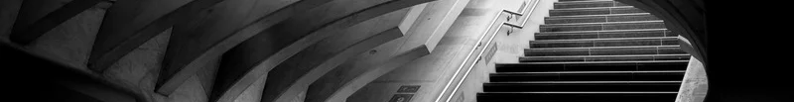
Problem Statement
The project propose is extracting information from images and different type of files, take them as input and extract any embedded text , return it in a readable format.
By leveraging advanced technologies like Optical Character Recognition (OCR) and AI-based image analysis, this project aims to develop a Python API that accepts various image formats and types of text content, providing clean and organized data extraction for improved information management.

Slide 3
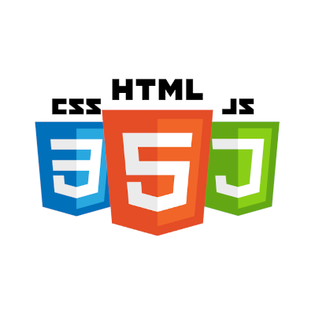
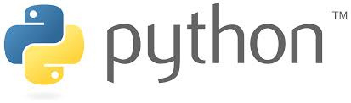

Technologies Used
Frontend :
Language Used :
Framework :

Slide 4
Flask :
A lightweight web framework for building web applications and APIs in Python.
A pure python search engine library. It contains :
indexing
searching
Whoosh :
pytesseract :
It allows you to extract text from images using Optical Character Recognition (OCR).
PIL (Pillow) :
Pillow is used for opening, manipulating, and saving various image file formats.
pdfplumber :
A Python library for extracting text, tables, and metadata from PDF files .

Slide 5

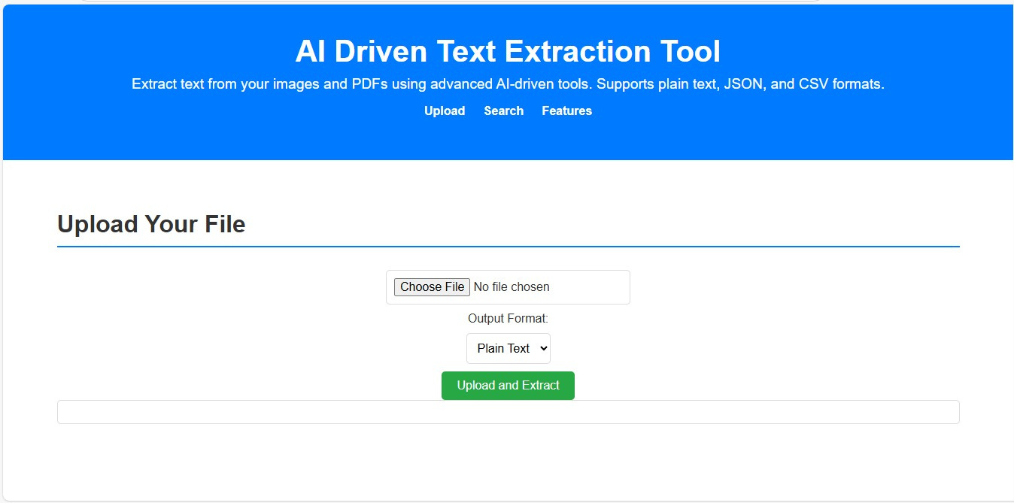
UI for uploading file and extracting tha information

Slide 6
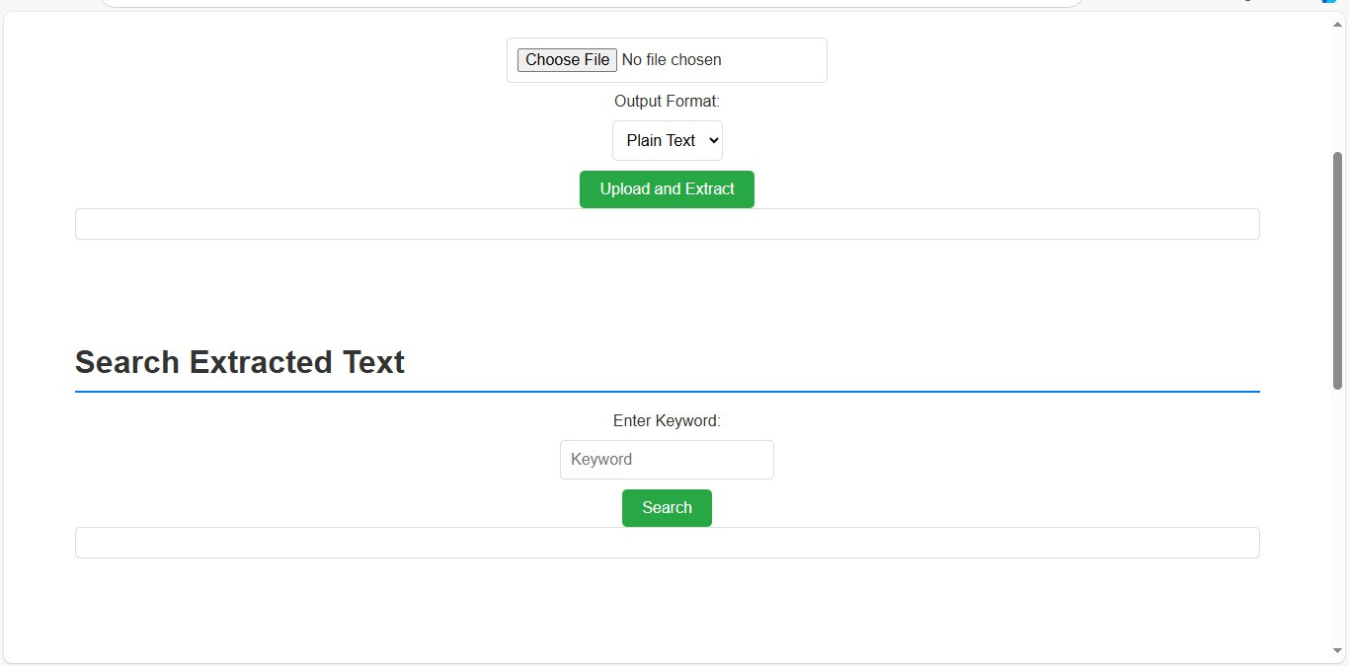

Slide 7
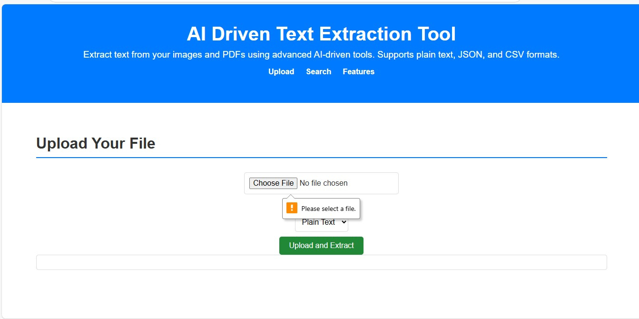
Try to extract information without uploading the file

Slide 8
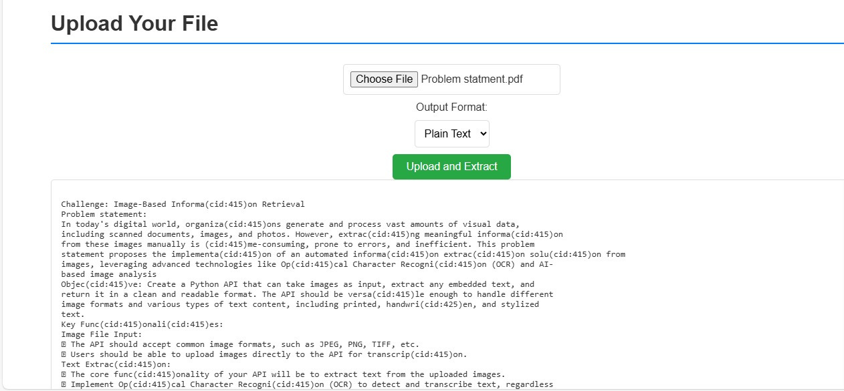
OUT PUT :

Slide 9
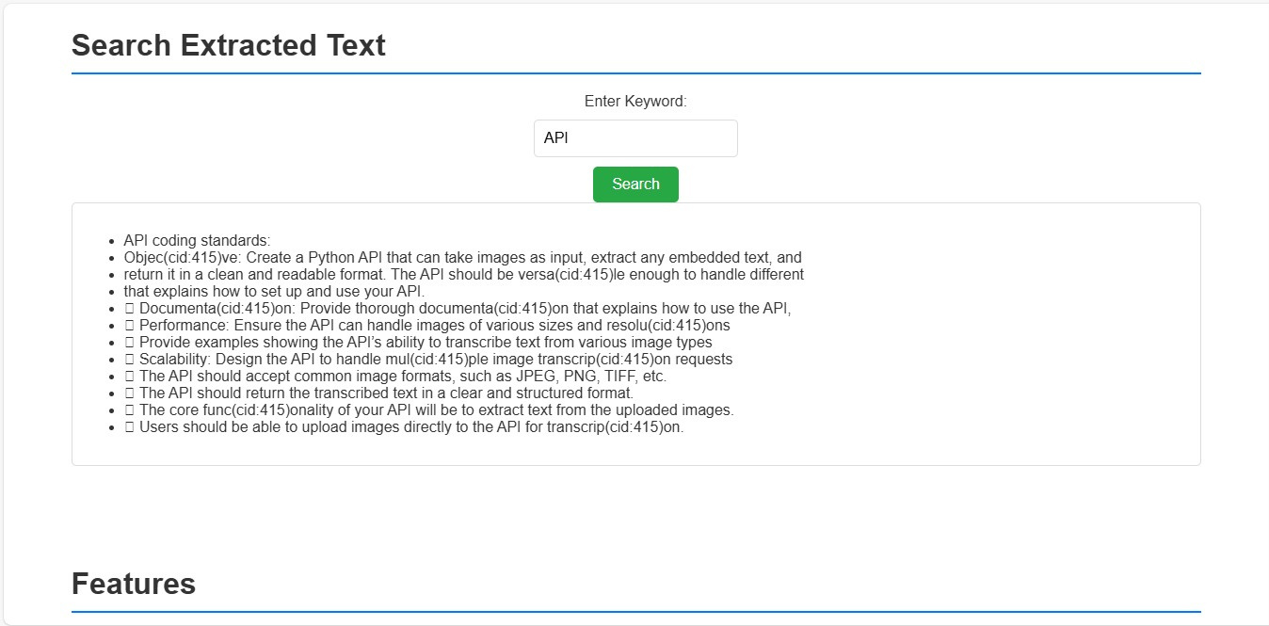
CONCLUSION :

Slide 10
THANK YOU

